Slide 1


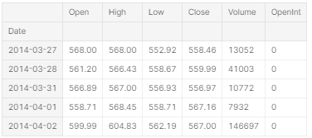
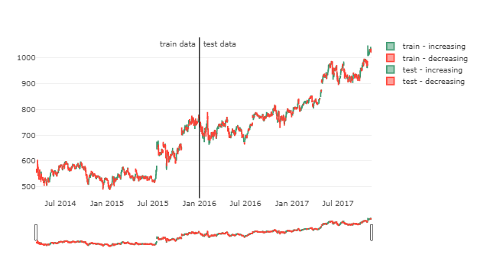
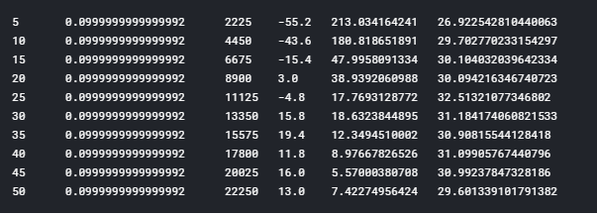
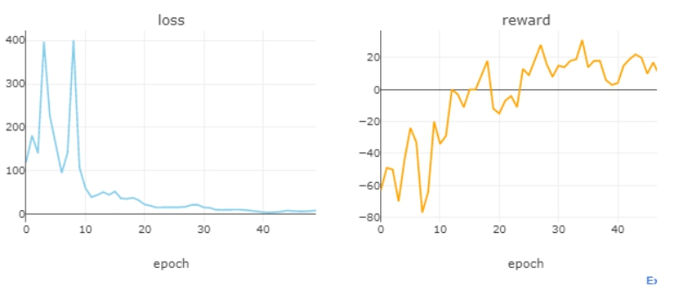
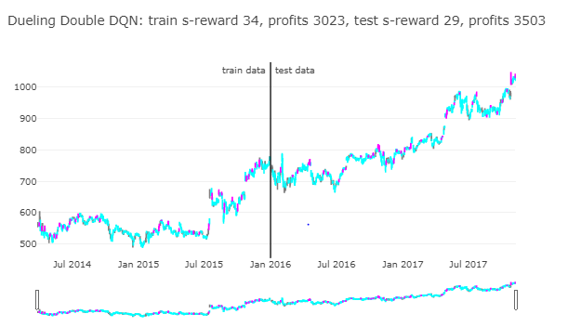

Design and implement a stock market predictor using a Reinforcement Learnings
PROJECT MEMBERS
Arsh Srivastava
Shaik Nafi Izaaz
Denicke Solomon H
Nidhi Shukla
MARRI BINDU MADHAVI
MENTORS:
Dr.Hirenkumar B Thakkar
Assistant Professor,
Dept. of Computer Science & Engineering,
Bennett University, India.
Abstract
Now a days biggest challenge in stock market is to predict the prices of a stock because of its complexity.In stock market prediction our aim is to predict the future value of a company stock.AI can predict prices of stock more accurately than humans.AI can do analysis of stocks using past data .we focus on ml algorithm approach that will trained from available stock data and it will gain some intelligence and use that knowledge in predicting future price of a stock. The proposed algorithm provides better prediction accuracy of both profit and rewards. The focused model implemented by taking HUGE STOCK MARKET DATASET.
1.2 Before applying this algorithm plotting the graph.
Introduction
Stock market prediction is a challenging and intelligent task in the present-day world. Usually stock markets try to predict the value of a company in future. The successful prediction of a stock's future price is challenging because it could yield significant profit for the company or loss for the company. Public is also interested to buy or sell shares of a company based on this stock markets prediction. Moreover, internal factors such as change of CEO, CTO and the external economic, political, natural events such as outbreak of pandemics, floods, cyclones also influence the stock price of a company directly. This clearly shows that analysis and prediction of stock values plays a major role in the success of a company or industry.
Fundamental and technical analysis are carried out to understand Stock markets. Fundamental analysts consider the difference between the value of a stock and its trading price. Technical analysts are concerned with the clues influencing the stock's supply and demand dynamics, which in turn determines the price of the stock. Actually they try to predict the future value of stock based on the stock trends in the recent past. The Japanese candle stick patterns are being used in technical analysis.The various types of reinforcement learning algorithms are used in prediction. Q learning is an Off-policy algorithm to find the optimal movement to be taken given a state ‘p’. The policy of Q learning tends to maximize the total reward involved in the system. In Q learning, dueling double deep Q network provides a significant improvement in the learning and hence the prediction. In this project work, a variant of Q network namely dueling double deep Q network (DDDQN) is used for predicting stock prices of a company or industry.
1.3 After applying duelling double DQN algorithm. 1.3.1 Plotting value of epoch, epsilon, total steps, log rewards, log loss, elapsed time.
1.3.2 Plotting total number of losses and rewards.
1.3.3 Plotting total number of rewards and profits in train and test data after applying the algorithm.
Proposed Method
Reinforcement learning (RL) is an area of machine learning that focuses on how you, or how some thing, might act in an environment in order to maximize some given reward. A commonly referred to domain that can illustrate the the powerof reinforcement learning is in game playing.
Dueling Deep Q Networks
The Dueling Deep Q Networks architecture is based on the idea that the evaluation of the Q function implicitly calculates two quantities:
1.V(s) — the value of being in state s
2.A(s, a) — the advantage of taking action a in state s
Number of Epochs : 50
SThe Q function can therefore be expressed as :
Q(s,a) = A(s,a) +V(s)
The Advantage function expresses the relative benefits of the
various actions possible in state s.
Here it provides maximum rewards with less number of losses. So it gives quite nice results with maximum accuracy.
Conclusions
This paper presents an approach for stock market prediction using reinforcement learning. It is an alternative way of representing target values for the patterns in stock market price changes. Our result shows that the duelling double DQN algorithm can be utilized for stock trading. Dueling DQN is more accurate than DQN in calculating the optimal Q value, therefore, the strategy switching is more frequent and the recognition accuracy is higher in testing set.
Experimental Results and Discussion
References
1.1 The dataset on which we are applying these algorithm.
Jae Won Lee, School of Computer Science and Engineering,
Sungshin Women’s University,Seoul, 136-742, South Korea.
S.M. Kendall and K. Ord, Time Series, Oxford University
Press, New York, 1997.
Team No. - 52

